Slide 1


Social Buzz
Presented By Rohini Kadam

Slide 2


Today's agenda
Project recap
Problem
The Analytics team
Process
Insights
Summary

Slide 3

Accenture partnered with Social Buzz for a 3-month pilot project to tackle their biggest challenges. We're helping a global unicorn company manage its large-scale operations. Our work includes reviewing their big data practices, supporting them in preparing for a successful IPO, and analyzing their data to identify the top 5 content categories. Our data analytics team is focused on delivering these insights.
Project Recap

Slide 4


Problem
Over 100000 Posts per day 36,500,000 pieces of content per year.
But how to capitalize on it when there is so much? Analysis to find social Buzz’s top 5 most popular categories of content

Slide 5



Andrew Fleming Chief Technical Architect
The Analytics team
Marcus Rompton Senior Principle
{Myself} Data Analyst

Slide 6
Data Understanding
Process
1
Data Cleaning
2
Data Modeling
3
Data Analysis
4
Uncover Insights
5

Slide 7
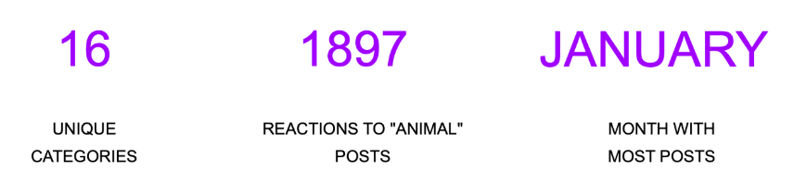

Insights

Slide 8
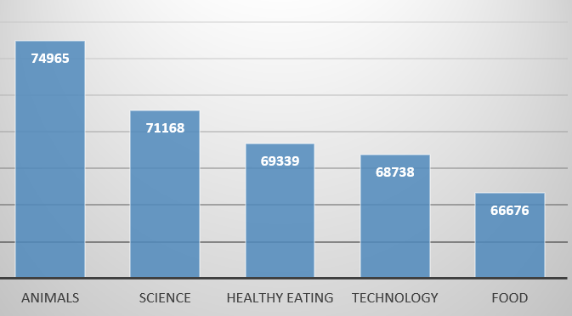
Top 5 Categories by aggregate Popularity score

Slide 9
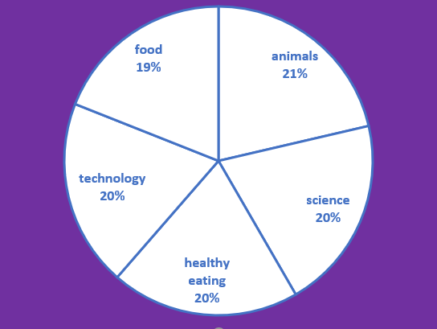
Top 5 Categories by aggregate % share

Slide 10

Users love “real-life” and “factual” content like animals and science. Food is a big hit too, especially healthy eating. This tells us about the kind of users on your platform. You could create special content or partner with healthy eating brands to get more engagement. For instances, run campaigns or share content focused on healthy eating to attract more attention.
Summary

Slide 11

Thank you!
ANY QUESTIONS?

